Slide 1
Convolutional Neural Nets (CNN)
How to process Images

Slide 2
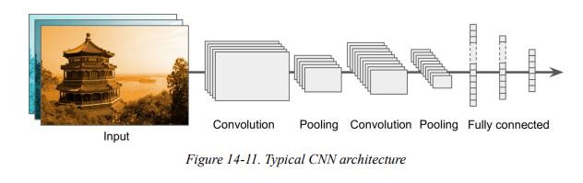
Very Simple Explanation of CNN

Slide 3
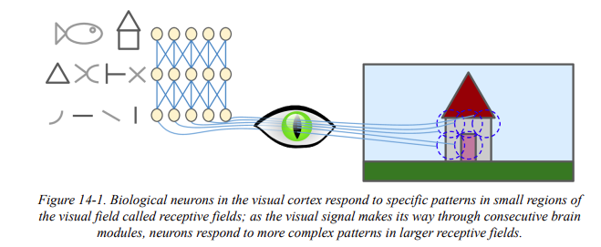
Receptive Field

Slide 4
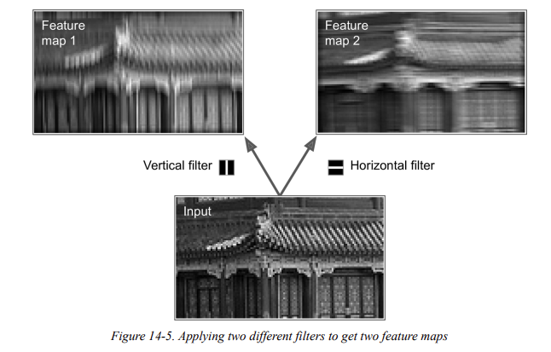
Applying Filters

Slide 5
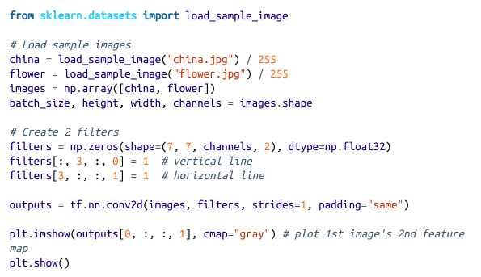
A Simple code

Slide 6
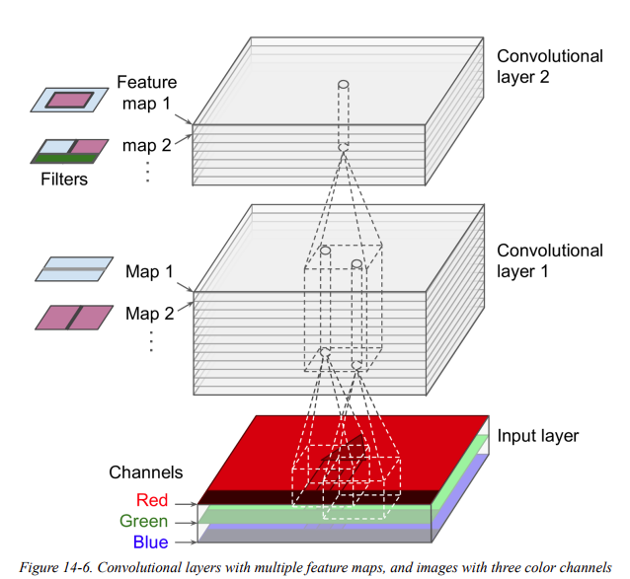

Slide 7
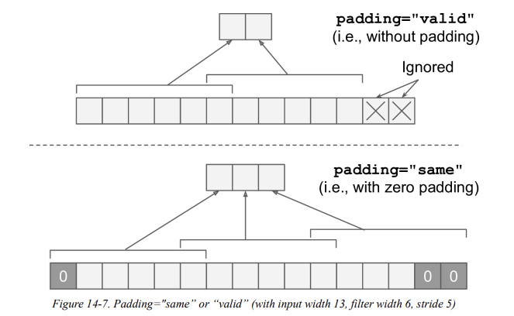
1D Image Convolution

Slide 8
Convolutional Layer
Image Source: https://teknoloji.org/cnn-convolutional-neural-networks-nedir/

Slide 9
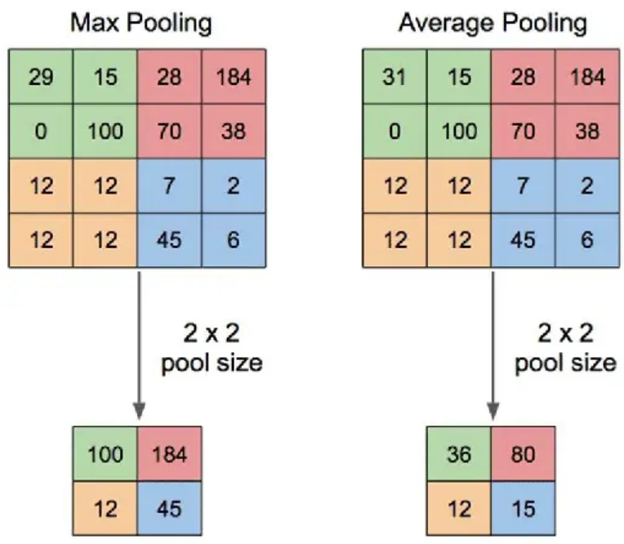
Pooling Layer

Slide 10
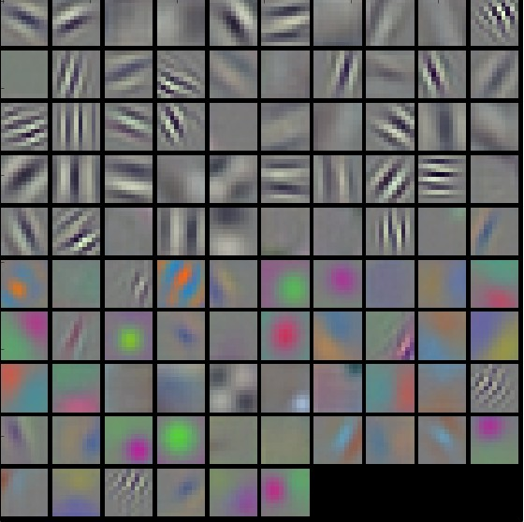
Pattern
Visualization

Slide 11
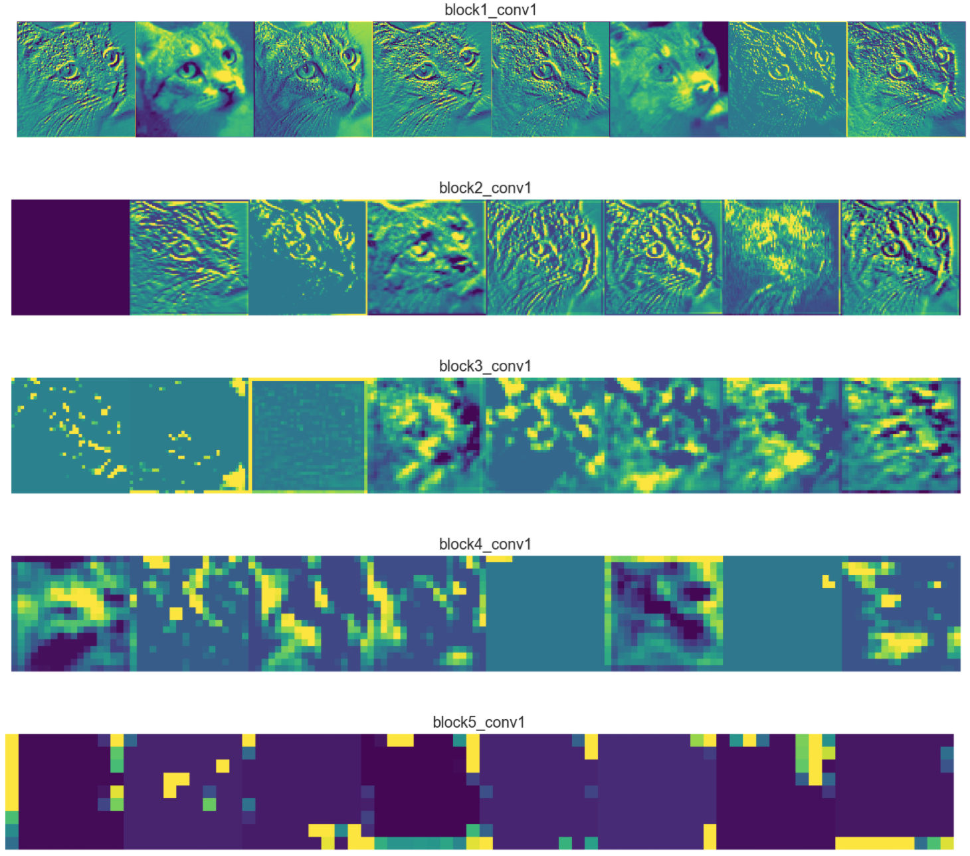
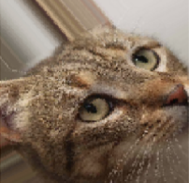
How patterns
Transform
an image

Slide 12
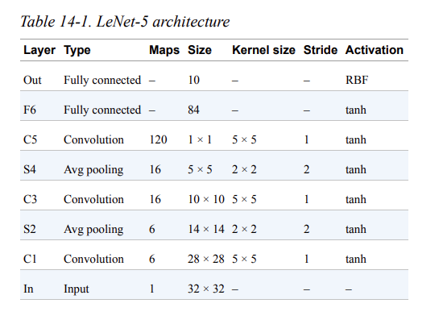

Slide 13
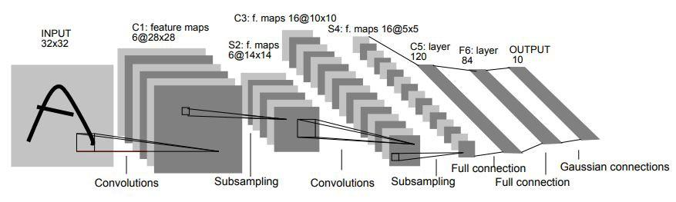
LeNet: From Original Paper

Slide 14
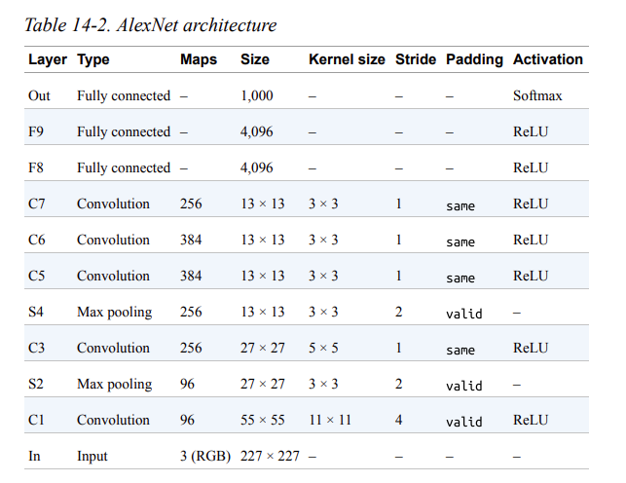
AlexNet

Slide 15
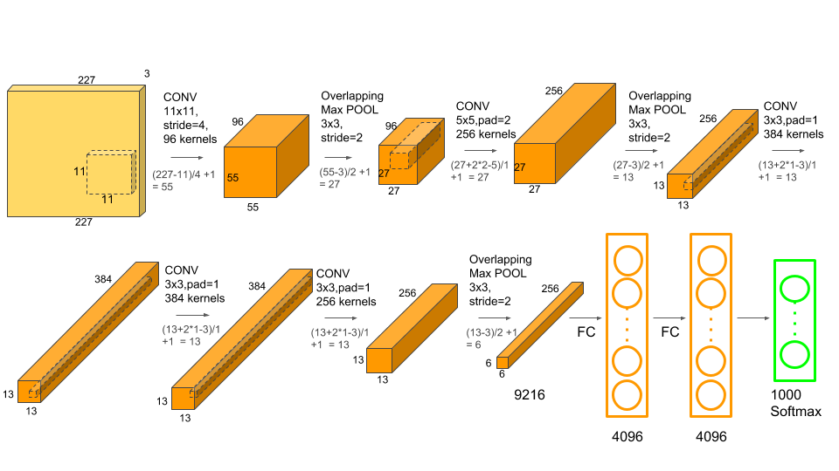
AlexNet

Slide 16
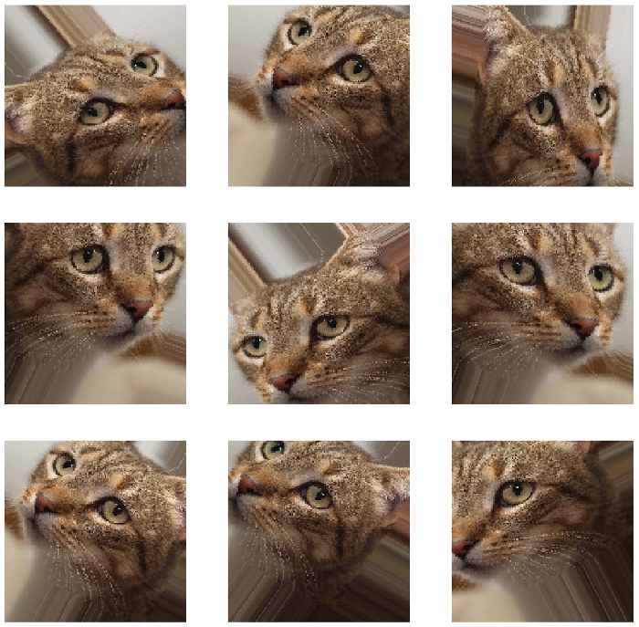
Data Augmentation
Image Source: https://towardsdatascience.com/applied-deep-learning-part-4-convolutional-neural-networks-584bc134c1e2

Slide 17
